Slide 1
Web and mobile app development – csc3054/7054
2.1 User Interface

Slide 2
Most downloaded applications
App | Developer | Date Reached
YouTube | Google | 2014-07
WhatsApp Messenger | WhatsApp Inc. | 2015-03-04
Messenger | Facebook | 2015-06-06
Google+ | Google | 2015-01-06
Google Text-to-Speech | Google | 2015-03-27
Google Search | Google | 2014-12-08
Google Maps | Google | 2014-05-28
Google Hangouts | Google | 2015-06-14
Google Chrome | Google | 2015-06-14
Google Books | Google | 2015-06-02
Gmail | Google | 2014-05-06
Facebook | Facebook | 2014-09-02

Slide 3
What did we discuss previously?
Android system architecture
Installation of Android SDK
Created an Android app

Slide 4
Questions to be answered
What is silent toggle mode app about?
How to create an image or a button and show it on the screen?
How to define width/height of an image or button?
How to define the location of an image or button?
What is the difference between the layouts of using linearlayout and relativelayout?

Slide 5
Content outline
A silent toggle mode application
Build the UI
Summary
Next lecture
Further readings

Slide 6
basics – silent toggle mode application
What is it?
To switch phone from ring to silent mode or vice versa.
Why do we learn this application?
A good example of UI
Link an image with a button
Use of event handler
Demo…

Slide 7
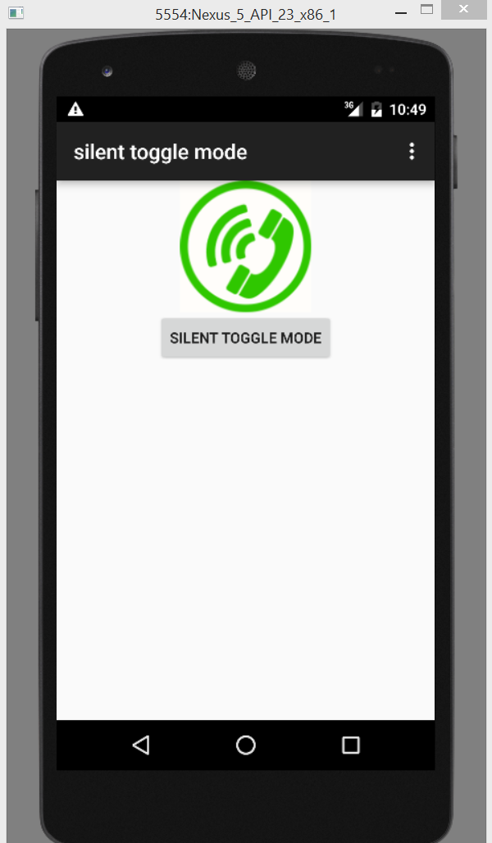
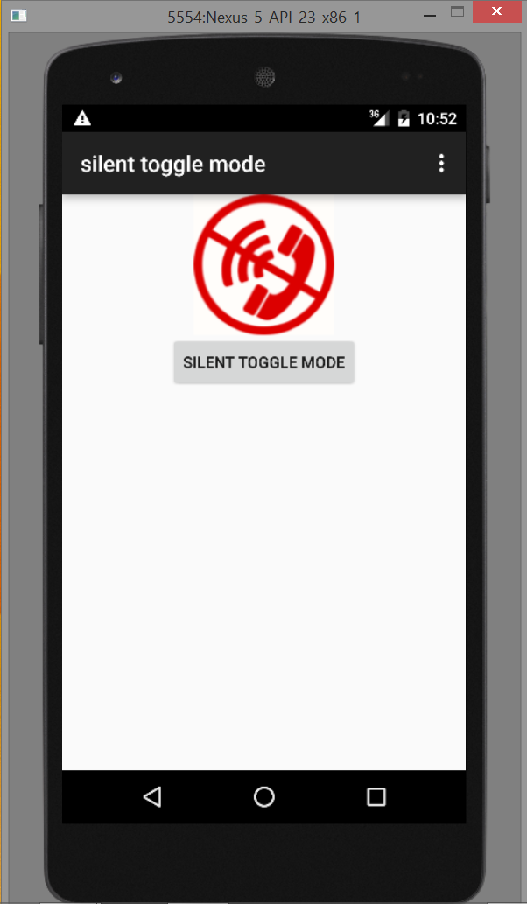
a silent mode toggle application

Slide 8
Content outline
A silent toggle mode application
Build the UI
Summary
Next lecture
Further readings

Slide 9
Project design flow – general
Requirements collection.
Composition of use cases.
Draft methods/behaviours/classes.
Optimisation of functionalities.
Determination of class diagrams.
Organisation/implementation of classes using OOP principles.

Slide 10
Class diagram example – make cookie
Start
Preheat
oven
Blend salt, vanilla…
Chop nuts
Add sugar/flour
Mix Chocolate/nuts
Bake and cool
Serve

Slide 11
Target appearance

Slide 12
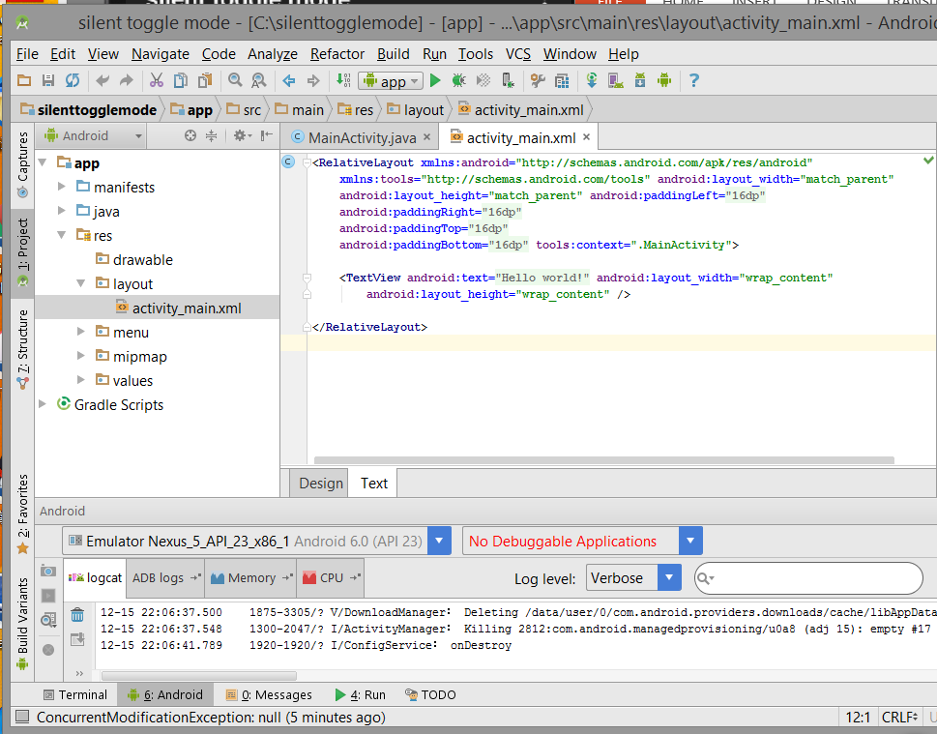
use the xml layout file of “helloworld”
activity_main.xml in the res/layouts folder
Notes:
Android:text – provides classes used to render or track texts on the screen.

Slide 13
Xml layout attributes
RelativeLayout: to specify the location of child objects relative to each other.
xmlns:android=“...”: to define the XML namespace to reference part of the Android SDK.
android:layout_width="match_parent”: to make the width as wide as it can be within the parent.
android:layout_height="match_parent”: to make the height as high as it can be within the parent
android:paddingLeft=“16dp”: to set the padding, in pixels, of the left edge.
tools:context=“.MainActivity”: to find the right theme based on the activity.
android:layout_height=“wrap_content”: to display the item high enough to enclose its content.

Slide 14
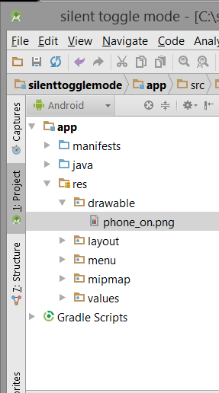
place an image on the screen
How to put the phone image into the res/drawable folder in the project?
phone_on.png
phone_off.png
Notes:
What resolution of the images to be put in each folder?

Slide 15
Change the layout
<LinearLayout xmlns:android="http://schemas.android.com/apk/res/android"
xmlns:tools="http://schemas.android.com/tools"
android:orientation="vertical"
android:layout_width="match_parent"
android:layout_height="match_parent"
tools:context=".MainActivity" >
<ImageView
android:id="@+id/phone_icon"
android:layout_width="wrap_content"
android:layout_height="wrap_content"
android:layout_gravity="center_horizontal"
android:src="@drawable/phone_on"/>

Slide 16
Image properties
android:id=“@+id/phone_icon” : The id attribute defines the unique identifier for the view in the Android system.
android:layout_width="wrap_content”: Informs the Android system to only take up as wide as needed to show the view.
android:layout_height="wrap_content”: Informs the Android system to only take up as high as needed to show the view.
android:layout_gravity: This defines how to place the view, both its x- and y-axis, with its parent.
android:src=”@drawable/phone_on”: This is a direct child of the ImageView class.

Slide 17
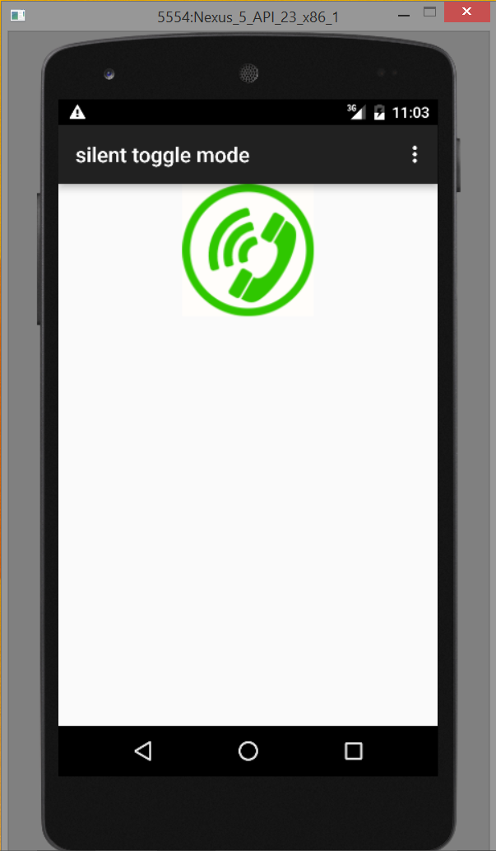
Intermediate outcome

Slide 18
Add a toggle button on the bottom
<Button
android:id="@+id/toggleButton"
android:layout_width="wrap_content"
android:layout_height="wrap_content"
android:layout_gravity="center_horizontal"
android:text="Silent Toggle Mode"/>

Slide 19
set the background colour
Select the activity_main.xml tab.
Make the background “white” to the LinearLayout: android:background=“#ffffff” (colour code: http://www.color-hex.com/).
It looks like this:
<LinearLayout xmlns:android=“http://schemas.android.
com/apk/res/android”
android:orientation=“vertical”
android:layout_width=“fill_parent”
android:layout_height=“fill_parent”
android:background=“#ffffff”>
Save it.

Slide 20
Exercises
Can you place the button on top of the image?
Can you place the image and the button on the same row (horizontally)?
What about moving the image/button to the left or right?

Slide 21
Content outline
A silent toggle mode application
Build the UI
Summary
Next lecture
Further readings

Slide 22
Summary
Introduction of silent toggle mode app.
Locate an image and a button.
Link with an image and show it on the screen.
Create a button and then show it on the screen.

Slide 23
Content outline
A silent toggle mode application
Build the UI
Summary
Next lecture
Further readings

Slide 24
next lecture
To learn how to make an event handler.

Slide 25
Content outline
A silent toggle mode app
Build the UI
Summary
Next lecture
Further readings

Slide 26
Further readings
http://developer.android.com/training/index.html
Android Application Development for Dummies, Donn Felker, Wiley Publishing, Inc., NJ, 2011.

